Slide 1

ICBP 2.0
Carbon Footprint Optimization in Supply Chain Logistics
Your Name : Vijayalakshmi G
Team Name : Skill 4 Future
Project GitHub Link:

Slide 2
Content
Problem Statement
Objective
Dataset
Exploratory Data Analysis (EDA)
Model Selection
Model Architecture (For Deep Learning Projects)
Training & Evaluation
Results
Conclusion & Future Work
References & Acknowledgements
Notes:
Here we are going to learn,
Text classification involves assigning categories to text, commonly applied in spam detection. It requires preprocessing (tokenization, stopword removal) and vectorization (e.g., TF-IDF). Models like Naive Bayes or Logistic Regression are trained and evaluated using metrics like accuracy and F1-score.

Slide 3
Problem Statement
Traditional logistics systems primarily optimize for cost and time, often overlooking the environmental impact. With the rise of sustainability goals and climate regulations, there is a growing need to minimize the carbon footprint of supply chain logistics.
Notes:
Need to discuss about :
What problem are you solving?
Why is it important?

Slide 4
Objective
To develop a Streamlit-based application that utilizes machine learning to predict and reduce carbon emissions in logistics by optimizing delivery routes based on multiple factors like distance, cargo, weather, and traffic.
Notes:
Need to discuss about :
Clear goals of the project
What you aim to achieve with AI/ML/DL

Slide 5
Dataset
A Real dataset has10,000 samples was taken from the Kaggle with the following features:
route_distance_km
fuel_type_encoded (0: diesel, 1: petrol, 2: electric)
avg_speed_kmph
cargo_weight_kg
temperature_c
wind_speed_kmph
traffic_index
humidity_percent
road_condition_index
vehicle_age_years
The target variable is carbon_emission, calculated using a domain-informed formula with added noise for realism.

Slide 6
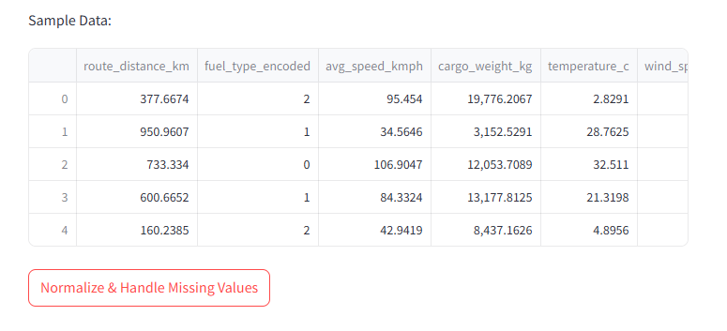
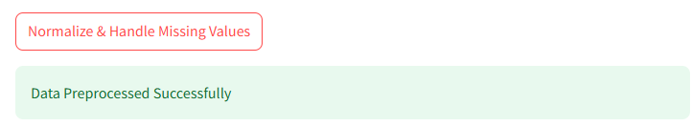
Exploratory Data Analysis (EDA)
Basic statistical summaries and correlation plots were used to:
Understand feature distributions
Identify outliers
Assess relationships between features and target variable
Step 1.
Step 2. click
Notes:
Need to discuss about :
Graphs, distributions, insights
Handling missing values, outliers, etc.

Slide 7
Model Selection
Load preprocessed features, target, and scaler from st.session_state.
Build a feed-forward neural network regression model with TensorFlow/Keras.
Train the model on the prepared data with validation split.
Use early stopping to avoid overfitting.
Save the trained model (.h5 format) and scaler (joblib).
Update session state to indicate model is trained.
Train a deep learning model to predict carbon emissions.
Notes:
Need to discuss about :
Which algorithms/models did you try? (e.g., CNN, RNN, Random Forest)
Justify your choices (especially in DL projects)

Slide 8
Model Architecture (For Deep Learning Projects) - optional
User Uploads Data
Data Preprocessing
Model Training
Save model
Save scaler/features
Model Evaluation
Display metrics
Prediction
Notes:
Need to discuss about :
Layers used (Conv, Pool, Dense, Dropout)
Diagram of architecture
Parameters/Hyperparameters

Slide 9
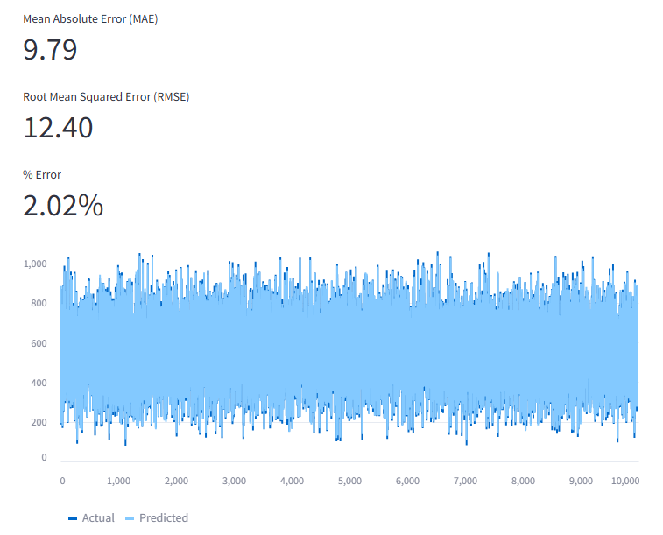
Training & Evaluation
The model was trained using 100 estimators. Evaluation metrics used:
MAE (Mean Absolute Error)
RMSE (Root Mean Squared Error)
% Error on predictions
Optionally load saved model and scaler.
Use a separate validation or test dataset.
Predict carbon emissions.
Calculate evaluation metrics such as MAE, MSE, RMSE.
Display metrics and plots (e.g., predicted vs actual scatter plot).
Notes:
Need to discuss about :
Training strategy
Loss function & optimizer
Accuracy, precision, recall, F1 score, confusion matrix

Slide 10
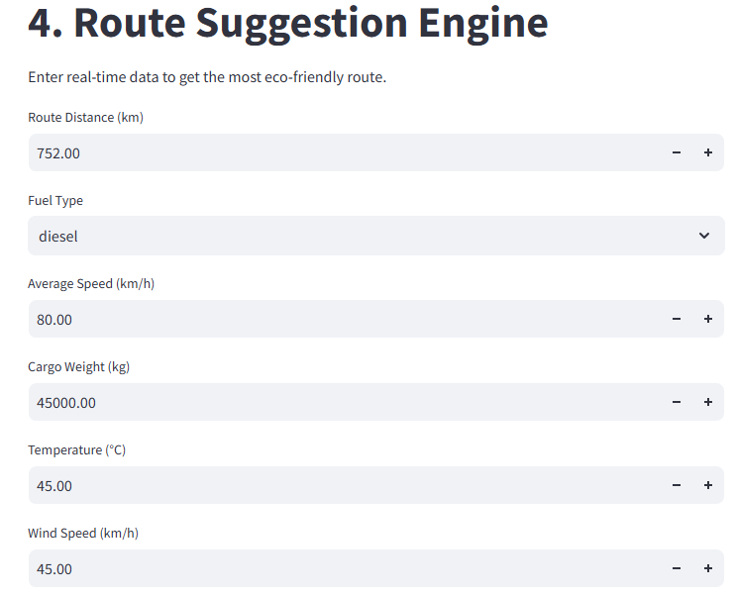
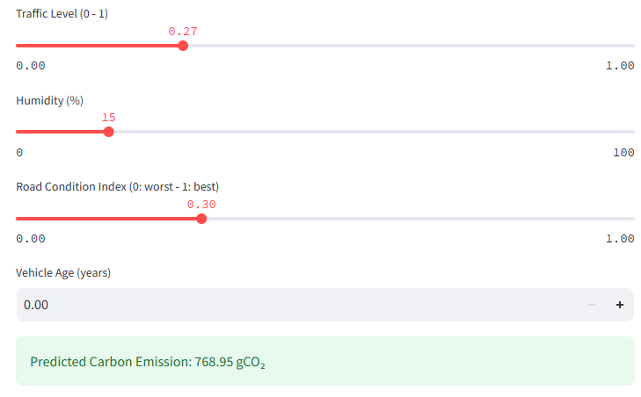
Results
Allow users to input new data and get carbon emission predictions.
Input form for new feature data.
Apply the saved scaler to the input.
Load the saved deep learning model.
Generate predictions.
Display predictions in an easy-to-understand format.
Notes:
Need to discuss about :
Visuals (graphs, images, etc.)
Comparison with baseline models (if any)
Inference speed, model size (for DL)

Slide 11
Conclusion & Future Work
The system effectively predicts carbon emissions and suggests eco-friendly routes.
Future improvements include:
Integration with real-time traffic and weather APIs
Visualization of route options on a map
Carbon credit and offset estimation
Deep learning pre-trained model for improved accuracy
Notes:
Need to discuss about :
Final thoughts
How the model can be improved or scaled

Slide 12
References
Goodfellow, I., Bengio, Y., & Courville, A. (2016). Deep Learning. MIT Press.
https://www.deeplearningbook.org/
TensorFlow official guide: Neural Network Regression
https://www.tensorflow.org/tutorials/keras/regression
Scikit-learn: Preprocessing data
https://scikit-learn.org/stable/modules/preprocessing.html
Regression with Neural Networks overview
https://machinelearningmastery.com/regression-tutorial-keras-deep-learning-library-python/
Evaluation metrics for regression (MAE, MSE, RMSE)
https://scikit-learn.org/stable/modules/model_evaluation.html#regression-metrics
Streamlit official documentation
https://docs.streamlit.io/
Notes:
Need to discuss about :
Papers, datasets, collaborators, tools used

Slide 13
Thank You

